Slide 2
semicolon
;

Slide 3
Agenda
;
semicolon
Introduction
Meet The Team
Why ; ?
Client Requirements – Challenges
Client Requirements – Goals
The semicolon; solution: Demonstration
Next Steps

Slide 4
Introduction
;
semicolon
Client: Todd – Tomorrow’s Voice
Project: TomorrowsVoices;
Dev-Team: semicolon;
Presentation Overview: Discussion and demonstration of TomorrowsVoices; Web Application System

Slide 5
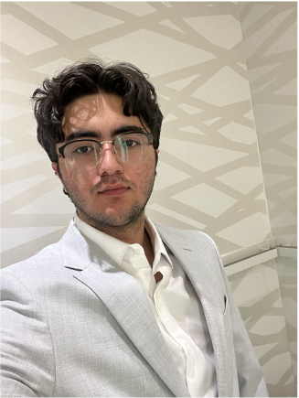
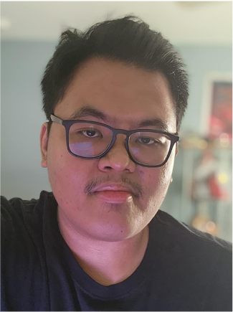
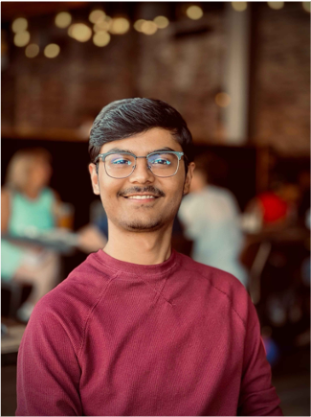
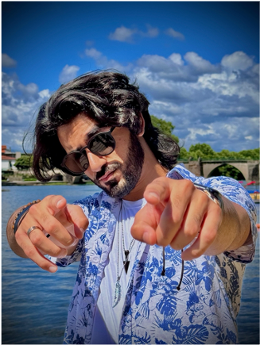
Meet the Team
;
semicolon
Radin Shahravan
Team Lead;
Communications Manager
Nyle Bumanglag
GitHub Manager; Disaster Recovery Manager
Sahil Patel
Team Scheduler;
Azure Hoster
Mohammad Yaseen
Presentation Coordinator

Slide 6
;
semicolon
Why ; ?
We’re a team of dedicated and skilled programmers, working to bring about the best results according to your requirements.
We’re optimised, efficient, and well versed with our work, with experience in our areas of expertise, upholding standard and quality with our product and services.
We uphold TIME as one of the core crucial currencies. Ours and yours!

Slide 7
Client Requirements - Challenges
;
semicolon
Choir Administration
Geographically Dispersed Operations
Attendance Tracking
Communication Needs
Volunteer Management
Current State – Google Sheet Signup
Future Expansion
Data Management
Reminders

Slide 8
Client Requirements - Goals
;
semicolon
Choir Administration
A centralized system to track weekly attendance.
A communication between directors and management; updates on weekly sessions.
Volunteer Management
A platform to make volunteer sign-ups more efficient.
Handle multiple events and programs.
A database that stores volunteer information.
A Volunteer Portal for volunteers to pick and view shifts.

Slide 9
Next Steps
;
semicolon
Get client feedback on current presentation and prototype.
Implement final feedback adjustments and any bug fixes.
Move forward with the project finalization.

Slide 10
;
semicolon
Let’s head to the demonstration…

Slide 11
;
semicolon

